Slide 1
4.2 Persistent Effects and Handoff
Notes:
# 4.2 Persistent Effects and Handoff — Content Guide
**Source:** `../Week 4 Overview.md`, `../labs/L4.2a_Adversary_Tracking/`, `../labs/L4.2b_Handoff_and_Partner_RAT_Deploy/`
**Audience:** CPT operators who completed Day 1 (L4.1a, L4.1b) and have working access to the adversary stack.
**Duration:** ~60 minutes (opening block of Day 2, Week 4)
**Prerequisites:** 4.1 Effects Operations Overview content guide, Day 1 labs.
**References:**
- `./4.1 Effects Operations Overview Content Guide.md`
- `../../week1/content-guides/5. MITRE ENGAGE Content Guide.md`
- `../../week1/content-guides/1. Tactical Planning Part 1 Content Guide.md` (for the CG/CV reference)
- `../lab_env/README.md`
---

Slide 2
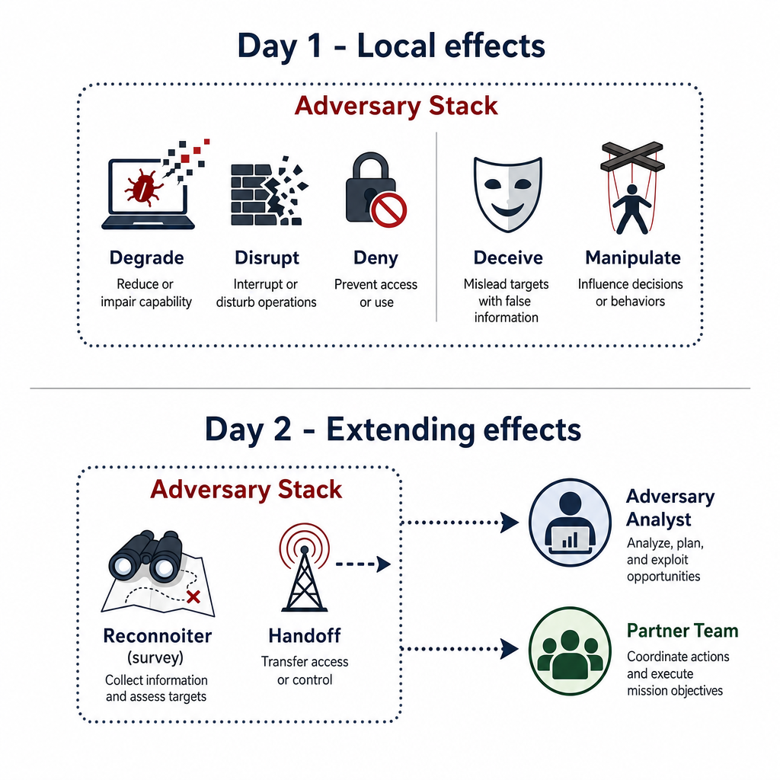
Yesterday We Denied and Deceived — Today We Survey and Hand Off
Day 1 effects (degrade / disrupt / deny collection and deceive / manipulate analysis) are local — they stop at the edge of the adversary stack
Day 2 effects (reconnoiter via survey methods, then handoff) are extending — they reach past the adversary stack to collect technical and behavioral data, then pass action-ready context to partner teams
These are the effects CPT commanders most care about because they generate options for pursuit
They also demand the highest documentation discipline because another team may execute based on what you report
Notes:
Say:
"Yesterday you produced effects that lived and died inside the adversary stack. Today you reach out past that stack. Survey is how you execute reconnoiter in practice — you collect technical and behavioral facts from the adversary workflow and turn them into pursuit-enabling intelligence. Handoff deploys another team's capability from your foothold when needed — that is a force-multiplier. These are the effects that make a CPT valuable outside its own enclave."
Show:
The local-vs-extending graphic.
Do:
Ask: "At your home unit, where does a partner team usually get stuck first: incomplete technical detail, unclear behavioral context, or both?" Use answers to frame why today's reporting quality matters.
Image Prompt:
A two-row graphic. Top row labeled "Day 1 - Local effects" with small icons for Degrade/Disrupt/Deny and Deceive/Manipulate, constrained inside a dotted box labeled "Adversary Stack." Bottom row labeled "Day 2 - Extending effects" with icons for Reconnoiter (survey) and Handoff, arrows breaking out of the dotted box toward labeled targets "Adversary Analyst," "Partner Team."

Slide 3
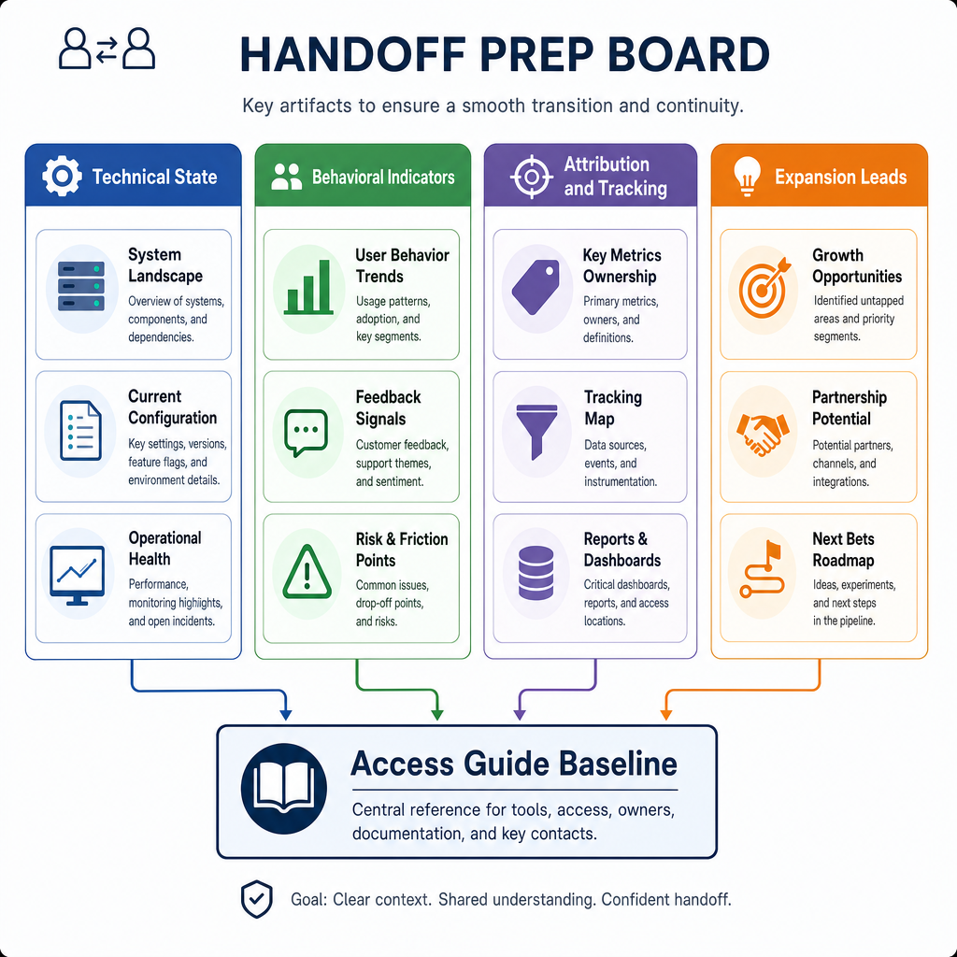
Situational Awareness Package from Prior Survey
Initial access work from last week already produced a first-pass awareness picture; today we package that picture for partner action
Organize existing survey-derived observations into four buckets:
  Technical state — host, user, process, service, and network facts from the current foothold
  Behavioral indicators — cadence, handling patterns, and likely next adversary action
  Attribution and tracking support — infrastructure, timing, and routing clues that support "who is handling this" and "from where"
  Expansion leads — additional systems, users, services, or workflows revealed by current access
This package is the baseline for handoff quality: if these four buckets are weak, partner teams must re-discover before they can execute
Effect framing remains reconnoiter; operational product is an actionable Access Guide baseline
Notes:
Say:
"Do not treat this as raw log dump. Treat it as your situational awareness package from prior survey work. Four buckets: technical state, behavior, attribution-and-tracking, and expansion leads. This is what partners need first to decide if they can act now, need more evidence, or need you to collect additional detail before handoff."
Show:
The four-column package graphic; walk one concrete example in each column and map it to Access Guide fields.
Do:
Ask: "Which of these four buckets is usually weakest in your team handoffs, and what mission risk does that create?"
Image Prompt:
A handoff prep board with four labeled columns: Technical State, Behavioral Indicators, Attribution and Tracking, Expansion Leads. Each column contains 2-3 short example artifacts feeding an "Access Guide Baseline" box.

Slide 4
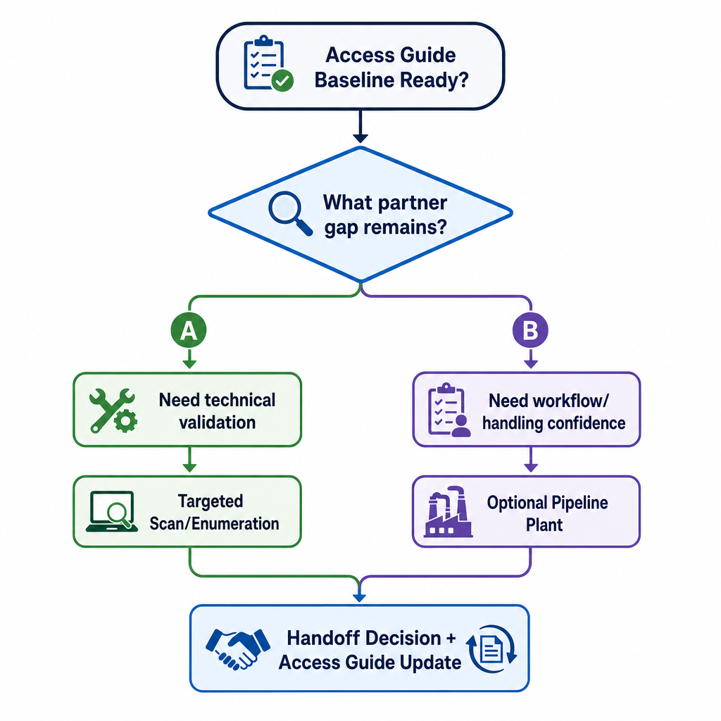
Additional Collection for Handoff Decisions and Success
Once baseline awareness is organized, collect only what closes partner decision gaps or handoff execution gaps
Two common additional-collection paths before/with handoff:
  Targeted scanning/enumeration from current foothold — gather missing validation on adjacent hosts, exposed services, user paths, and callback feasibility
  Pipeline plant (optional, informed) — introduce a controlled plant in a known adversary workflow when you need higher-confidence interaction evidence or persistent partner positioning
Selection logic:
  Use additional scanning when the gap is coverage, reachability, or technical validation
  Use a pipeline plant when the gap is workflow understanding, adversary handling confirmation, or partner persistence requirements
  Record purpose, expected evidence, and risk in the Access Guide before execution
Poor handoff prep is collecting "more data" without a stated partner decision it supports
Notes:
Say:
"Slide 2 gave the baseline. This slide is the gap-closure step. Ask what the partner still cannot decide or execute. If the gap is technical validation, scan with purpose. If the gap is workflow confidence or persistent positioning, consider a pipeline plant. In both cases, tie every action to a partner decision and capture it in the guide."
Show:
The decision flow and one example gap routed down each branch.
Do:
Ask: "Name one handoff decision your partner cannot make yet, then pick scan or plant and defend your choice in one sentence."
Image Prompt:
A decision flow: "Access Guide Baseline Ready?" -> "What partner gap remains?" -> branch A "Need technical validation" -> "Targeted Scan/Enumeration"; branch B "Need workflow/handling confidence" -> "Optional Pipeline Plant." Both branches feed "Handoff Decision + Access Guide Update."

Slide 5
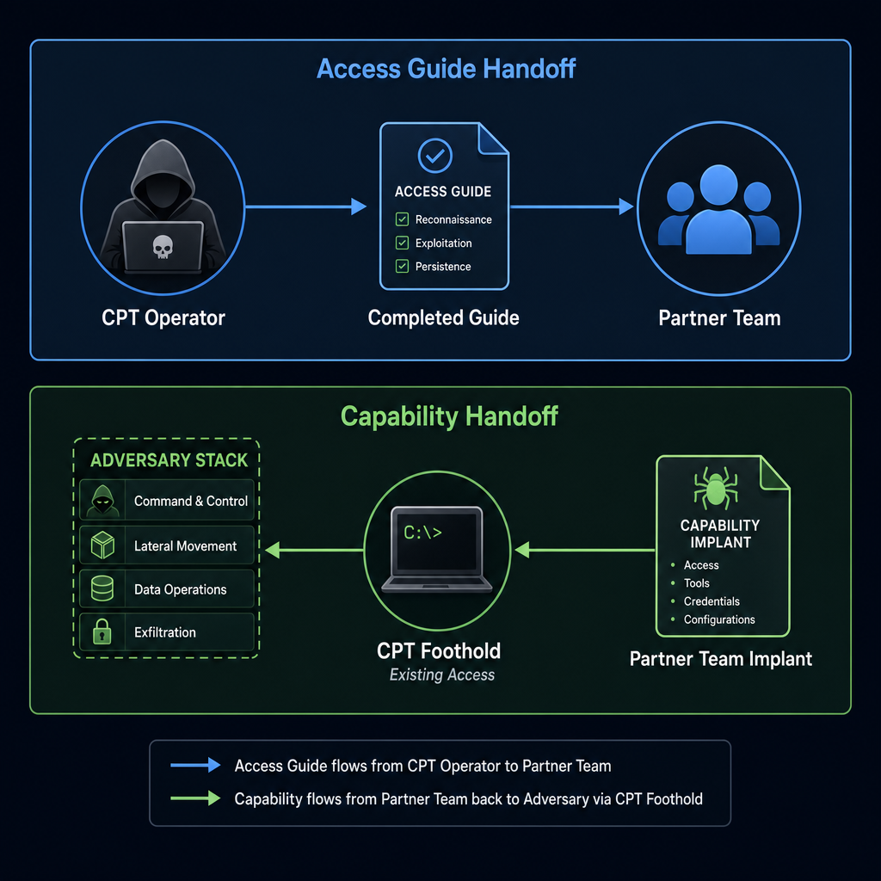
What "Handoff" Means in Cyber
Handoff = convert your tactical access into operational reach for someone else
Two flavors:
  Access Guide handoff — you package evidence so well that the partner team can act without re-discovering the target
  Capability handoff — you deploy the partner team's tool into your foothold and let them drive
Capability handoff is powerful and dangerous: you are now running someone else's code on a target that is still nominally your responsibility
CPT rule of thumb: the Access Guide must be good enough that the partner team could act without the capability handoff — the implant is an accelerator, not a crutch
Include the expansion rationale (scan vs plant) so partners understand how evidence was produced and where uncertainty remains
Notes:
Say:
"Handoff has two shapes. Access Guide handoff is you writing technical and behavioral context so clearly that another team can execute immediately. Capability handoff is you taking that team's tool and planting it in the position you already hold. Always produce the Access Guide first; only add capability handoff when partner mission need requires it."
Show:
The two-lane diagram; linger on "Access Guide first, capability second."
Do:
Ask: "If a partner receives only tool access but no Access Guide, what planning errors are most likely in the first 10 minutes?" Use answers to reinforce why guide quality comes first.
Image Prompt:
A two-lane diagram. Top lane labeled "Access Guide Handoff" shows a completed guide flowing from a CPT operator to a partner team icon. Bottom lane labeled "Capability Handoff" shows the partner team's implant icon flowing back into the adversary stack via the CPT foothold.

Slide 6
The Access Guide — What a Partner Team Actually Needs
Target identity — hostname, domain (if any), IPs, OS/kernel, key users
Access story — how you got in, what credentials/tokens/sessions you are holding, and how long they last
Current posture — what you have enumerated, what you have already changed (Day 1 effects go here), what you have not touched
Expansion method and findings — what follow-on method you chose (scan or plant), what it produced, and confidence level
Adversary tempo — cadence observed, next expected action, time-to-detect estimate
Partner tasking — what specifically you want them to do once they have their implant in place
Rollback plan — how to remove partner capability cleanly if mission direction changes
Notes:
Say:
"Write this template down. You will fill it in during L4.2b. This is not paperwork for its own sake — these seven sections are the questions a partner team will ask you in a five-minute sync call. If you cannot answer them crisply, they will not take the handoff, or worse, they will take it and do something you did not expect. The rollback plan is the section people skip and regret."
Show:
The seven-section template.
Do:
On the whiteboard, start a blank handoff template using yesterday's L4.1a lab target. Have the room call out what goes in each section. Tell them the L4.2b lab will grade them against this template.
Image Prompt:
A seven-section form/template graphic titled "Access Guide." Each section labeled with one of the seven bullets plus a one-line "what goes here" prompt.

Slide 7
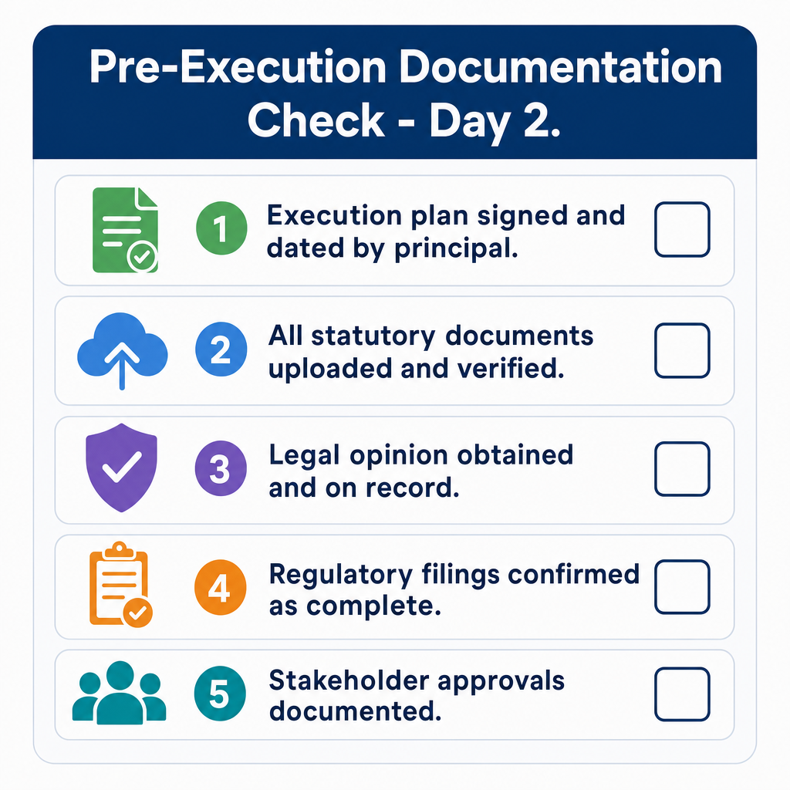
Documentation Discipline — Characterize the Target and Actor Precisely
Day 2 effects are only as good as the evidence quality you record
Your Access Guide must capture both:
  Technical characteristics — host/user/process/network/tooling details
  Behavioral characteristics — cadence, handling pattern, likely next action
Poor characterization creates partner rework and can delay action windows
Expansion decisions must be explicit so partners can reproduce or challenge your findings
Checklist before any Day 2 execution:
  1. Technical artifacts captured and timestamped
  2. Behavioral observations captured with confidence notes
  3. Expansion method selected (scan or plant) and justified
  4. Callback / implant destination validated
  5. Next-action estimate written in the five-line report
Notes:
Say:
"Today I am grading your characterization quality. A partner team acts on what you documented, not on what you meant. If technical artifacts are incomplete, behavioral observations are vague, or your expansion method is unexplained, you force rediscovery and lose tempo. Five-item check: technical evidence, behavioral evidence, method justification, validated destination, and next-action estimate. If any one is missing, stop and complete the record first."
Show:
The checklist graphic with the red header.
Do:
Run a dry check: pick one student at random, give them a notional action ("deploy the partner RAT to `adv-c2`"), and have them read the five-item documentation check aloud against it. Correct any missing items.
Image Prompt:
A five-box checklist graphic with header "Pre-Execution Documentation Check - Day 2." The five boxes are the five checklist items from the slide.

Slide 8
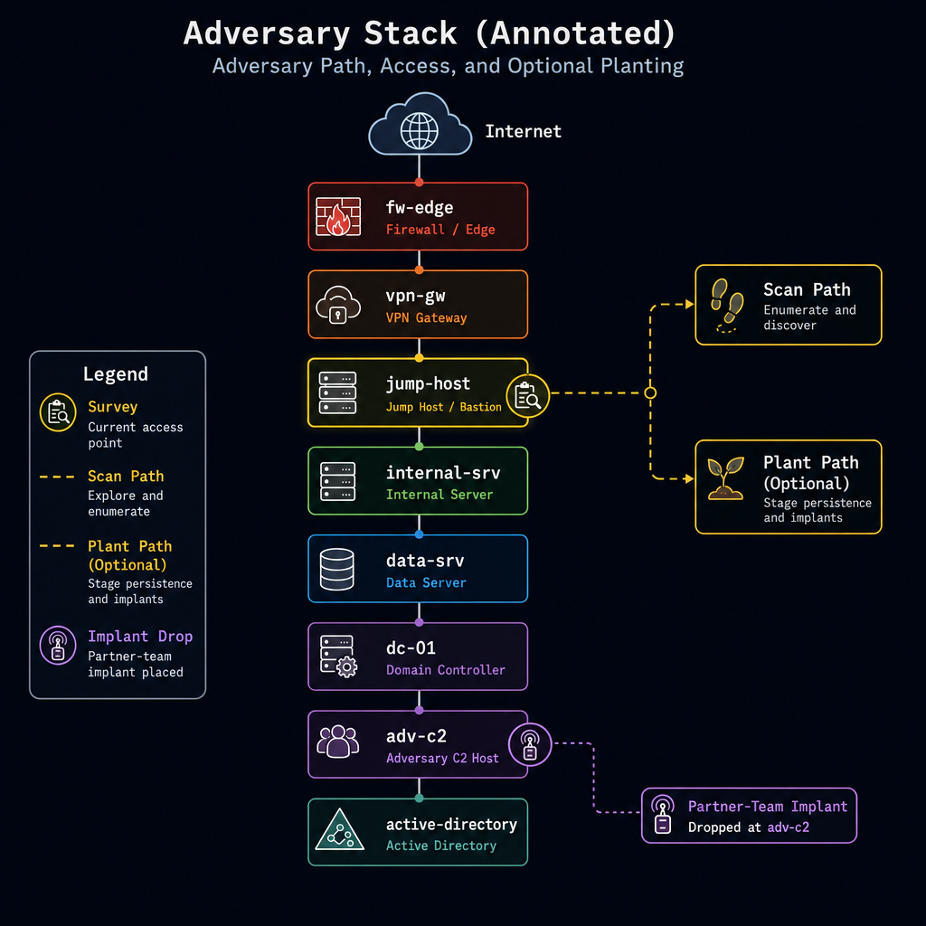
Today's Two Labs — L4.2a and L4.2b
L4.2a Adversary Tracking — run on-target survey from your current foothold, then expand with deliberate follow-on collection to produce tracking-grade telemetry
L4.2b Handoff and Partner RAT Deploy — produce an Access Guide and deploy an instructor-provided RAT binary into the adversary foothold, validating callback and documenting expected partner next actions
Both labs are graded on the effect report plus the Access Guide (L4.2b only)
End-of-day transition is the pivot to agentic operations — the adversary also automates
Notes:
Say:
"Two labs, both in extending territory. 4.2a starts with on-target survey and then deliberate expansion to refine tracking. 4.2b is a handoff effect with a live implant and a complete Access Guide. After 4.2b we do the pivot lecture for tomorrow — the adversary runs these same playbooks with AI help, and that is the rest of the week."
Show:
The annotated stack diagram.
Do:
Hand out the L4.2a student brief. Remind them that precision in collection and reporting is graded, not just successful callback. Break 15 minutes, then release to the lab.
Image Prompt:
Same adversary stack diagram as slide 7 of the 4.1 content guide, with two new annotations: a survey icon on the currently accessed node and a branch marker to "Scan Path" and "Plant Path (Optional)." Also show a partner-team implant icon being dropped at `adv-c2`.

Slide 9
Wrap — Transition to Agentic Operations
You have now run the Week 4 arc at least once: degrade / disrupt / deny, deceive / manipulate, reconnoiter (survey), handoff
Tomorrow: the adversary is doing all of this too, but faster — because they are using agents
You will spend three days building the same automation layer they are using, then counter-striking it
Tonight's read-ahead: ../Agentic Lesson Part 1 Outline.md and the first half of ../AI Part 1 Lecture Content.md
Notes:
Say:
"Look at what you ran in two days. Deny-or-degrade language on collection, deception on their analysis, reconnoiter via disciplined survey, then handoff when partners need to execute at tempo. One adversary stack. Human-paced. Now imagine an adversary running the same arc against you with a local LLM picking targets, tool-calling into your environment, and rewriting its own C2 on the fly. That is what Day 5 ends against. The only way you get good at defeating that is to build one first — which is what tomorrow is."
Show:
A simple four-box checklist labeled with the four doctrinal buckets from the slide bullets; check them all.
Do:
Collect the Day 1-2 five-line effect reports and handoff packages. Tell students these are the inputs for the Day 4 RAG agent — their own work becomes the agent's knowledge base. Dismiss.
Image Prompt:
No image required for this slide.

Slide 10
Questions?

